Slide 1

Front Range Fire Rescue
Community Safety Project
Phase 1 Report

Slide 2
Project Objective
Assist Front Range Fire Rescue Authority (FRFR) become a leader in community safety in mid-sized fire and rescue agencies in Northern Colorado by developing a comprehensive Community Safety Program.
The program should include the traditional roles of fire prevention, new efforts in wider community safety education and engagement and a larger cooperative role with the towns of Johnstown and Milliken, and Weld and Larimer Counties in emergency management.
The person managing this new major program should be able to participate in FRFR’s incident management system and as a member of the authority’s senior management team.

Slide 3
Three Phase Project
Phase 1 (March – June) | Phase 2 (July – August) | Phase 3 (September – December)
Develop Community Safety Model | Program Design | Develop candidate profile(s)
FRFR Internal Interviews | Staffing Requirements | Draft recruitment materials
FRFR Occupancy and Document Review | Program Function Descriptions | Advertise for and recruit applicants
Comparable Fire Agency Review | Job Descriptions | Manage screening process
Cooperating Local Government Interviews | Performance Objectives | Develop and adminioster assessment center
FRFR Comparison to Model | Budget | Manage selection process
Recommendations |  | Recommend Finalists

Slide 4
Primary Recommendation
Establish a comprehensive Community Safety Program
1.3 FTE
Traditional fire prevention staffing model
Fire Marshal at senior chief level
Full-Time(Community Safety Chief/Fire Marshal) | Part-Time/Contract/Position Share
New Development and Construction Code Enforcement Administrative Infrastructure Investigation | Education and Engagement Emergency Management

Slide 5
Secondary Recommendations
Update ERS Occupancy Data
Establish permit and plan review administrative process

Slide 6
Community Safety Model
New Construction
Emergency Management
Community Safety Program
Code Enforcement
Administrative Infrastructure
Education and Engagement
Investigation

Slide 7

New Construction
Review of new development and new/remodeled commercial buildings
Involvement in town and county development and building review process
Review and inspection of fire protection systems and special hazard systems
Involvement with water providers for fire flow planning, installation and maintenance
Fee systems

Slide 8
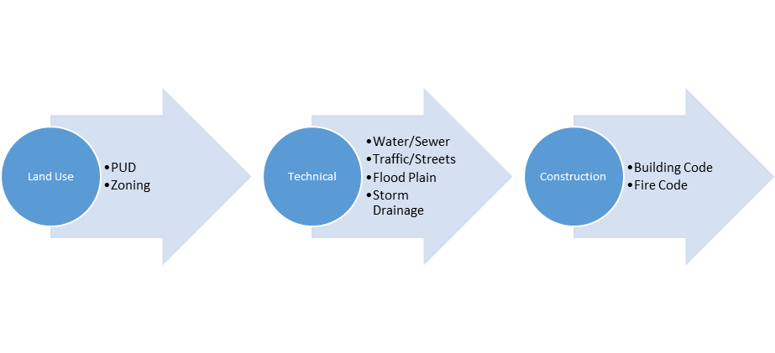
New Development and Construction Review

Slide 9
FD Involvement in Development Process
Referral from
land use and technical review
Full member of development team
from conceptual
and land use review

Slide 10
Fees
Some FD
Most FD

Slide 11

Code Enforcement
Inspection of target hazards
Regular inspection of non-target hazard occupancies
Permits (open burning, fireworks, hazardous materials)
Complaint response
Hazardous materials/LEPC

Slide 12
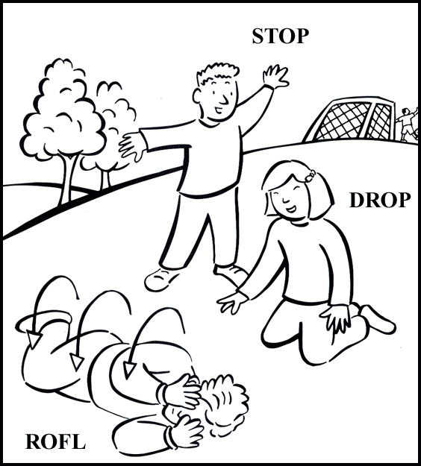
Education and Engagement
Elementary school/day care fire safety education
Community events
Senior citizen fire prevention education
Business education and training
Public information
Social media
Car seats
Community CPR/AED
Pre-hospital medical edcuation
Emergency preparedness education, COOP

Slide 13
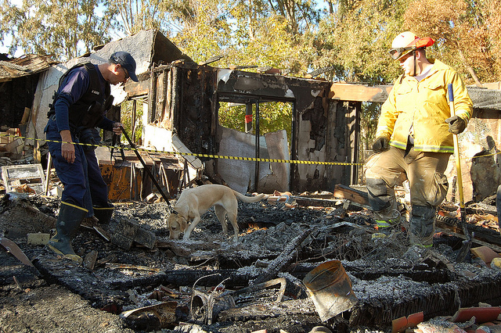
Investigation
Cause and origin determination
Cooperation with law enforcement on arson
Juvenile fire setter screening, education and referral
Cooperation with consumer safety agencies

Slide 14

Administrative infrastructure
Adoption and maintenance of fire code
Integration with towns and counties
Policies and procedures
Appeal systems
Staff training
Records
Occupancy data in ERS
Operations support
Pre-Planning

Slide 15
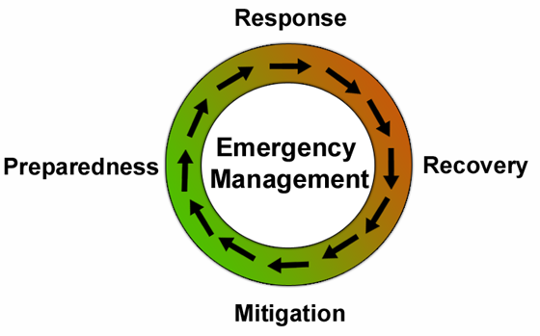
Emergency Management
Cooperation with towns and counties on emergency operation planning
Town EOP
Agency EOP
Emergency operations center
Participate in and plan exercises
Regional networks

Slide 16
Common Community Safety Organization
Community Safety Chief
Fire Prevention Chief
Fire Marshal
Inspector
Plan Reviewer
Technician
Specialist
Fire Protection Engineer
Investigator
Educator
Fire Chief
Community Safety
Operations
Admin

Slide 17

Research
Internal Interviews
Document Review
Occupancy Data
Comparable Fire Districts
Local Government Interviews and Data

Slide 18
Internal Interviews
New development and construction review, traditional fire safety education, community events are current FRFR community safety activities.
Minimal target hazard inspections by Fire Marshal “as time allows.”
No regular inspection of existing buildings.
No pre-planning activity in recent years.
Towns have different editions of Fire Code.
Increases in emergency responses, training and other duties have increased company workload and reduced available time for fire prevention activities at the shift level.

Slide 19
Internal Interviews (cont.)
Burn permit system is a current problem.
Some issues with water supply capacity.
Limited availability of Fire Marshal due to irregular hours.
Administrative infrastructure is minimal.
The plans review process allow plans and permit applications to be submitted at two locations. No consistent plan review tracking process, long delays for the deposit of plan review fees and fee process is not coordinated between the Fire Marshal and administrative staff.
Emergency management and preparedness activities are minimal in both towns and FRFR.

Slide 20

Occupancy Data
Approximately 250 occupancies in ERS, 350 estimated actual occupancies.
Occupancy data from Milliken has not been fully integrated into ERS system.
Not all occupancy data is recorded in ERS from either Johnstown or Milliken.
Some pre-planning information is included in ERS but level of detail is very low.
New occupancy data has not been entered or updated in ERS in recent years.
No target hazards identified (estimated 50).
Unable to identify fire protection systems, special hazard systems and hazardous materials use and storage over permit amount.

Slide 21

Document Review
Burn permit information sheet
Contractor information packet
Plan review fee and application form
Little data tracking and annual reports
Few community safety polices and procedures

Slide 22
Comparable Fire Districts
 | Berthoud | Evans | Front Range | Windsor | Frederick Firestone
Population | 17,500 | 21,000 | 22,000 | 26,000 | 27,000
Staffed Fire Stations | 2 | 1 | 2 | 3 | 4
Full-Time Personnel | 23 | 16 | 23 | 36 | 45
Commercial/Industrial Occupancies | 294 | 377 | 350 | 686 | 580
Target Hazards | 11 | 41 | 50 (Est) | 100 | NA
Schools | 8 | 6 | 7 | 9 | 8
New construction activity | Low | Moderate | Moderate | High | High

Slide 23
Comparable Fire District Community Safety Staffing
 | Berthoud | Evans | Front Range | Windsor | Frederick Firestone
New construction | .12 | .25 | .3 | .5 | .73
Code enforcement | .23 | .10 | .01 | .15 | .10
Education and engagement | .05 | 0 | .04 | .85 | 1
Emergency Management | .1 | 0 | 0 | 0 | .12
Administrative infrastructure | .15 | .05 | 0 | .25 | .1
Investigation | .05 | 0 | 0 | .05 | 0
Total | .7 | .4 | .35 | 1.8 | 2.05

Slide 24
Comparable Fire District Community Safety Staffing With Town Emergency Management
 | Berthoud | Evans | Front Range | Windsor | Frederick Firestone
New construction | .12 | .25 | .3 | .5 | .73
Code enforcement | .23 | .10 | .01 | .15 | .10
Education and engagement | .05 | 0 | .04 | .85 | 1
Emergency Management | .1 | 0 | 0 | 0 | .12
Administrative infrastructure | .15 | .05 | 0 | .25 | .1
Investigation | .05 | 0 | 0 | .05 | 0
Town EM |  | 1 |  | .8
Total | .7 | 1.4 | .35 | 2.6 | 2.05

Slide 25
Local Government Interviews
New construction activity in both towns is modest, approximately 30 new commercial building projects per year, relatively few buildable lots available in Johnstown in FRFR area.
Much long-term development potential in the western portion FRFR area but no indication of major new development in foreseeable future.
Short-term development potential in Milliken, although not at densities that would alter community safety needs in the near future.
In general towns are satisfied with the new development and construction review provided by FRFR. Plan review timelines are generally adequate although the Fire Marshal’s irregular hours sometimes contribute to long review times as well as scheduling and meeting attendance difficulties.
Neither town is currently involved in emergency management other than the towns each having Emergency Operation Plans that are 10 years old.

Slide 26
Research Triangulation
Internal Interviews, Documents
and Occupancy Data
Cooperating local
government interviews
Comparable Fire Districts
Interviews and Data

Slide 27

Comparison to Community Safety Model

Slide 28
FRFR Community Safety Program
New Construction
Community Safety Program
 | Berthoud | Evans | Front Range | Windsor | Frederick Firestone
New construction | .12 | .25 | .3 | .5 | .73

Slide 29
FRFR Community Safety Program
New Construction
Community Safety Program
Education and Engagement
Investigation

Slide 30
FRFR Community Safety Program
New Construction
Community Safety Program
Code Enforcement
Education and Engagement
Investigation

Slide 31
FRFR Community Safety Program
New Construction
Community Safety Program
Code Enforcement
Administrative Infrastructure
Education and Engagement
Investigation

Slide 32
FRFR Community Safety Program
New Construction
Emergency Management
Community Safety Program
Code Enforcement
Administrative Infrastructure
Education and Engagement
Investigation

Slide 33
Primary Recommendation
Establish comprehensive community safety program providing all six functions
1.3 FTE
Add annual target hazard inspection program (50)
Consider adding regular inspection program
Increase administrative infrastructure
Increase education and engagement beyond tradition fire safety
Add emergency management program in cooperation with towns and counties.

Slide 34
Recommended FTE
 | FTE Commitment
New development and construction | .3
Code enforcement | .3
Education and engagement | .25
Emergency Management | .15
Administrative infrastructure | .25
Investigation | .05
Total | 1.3

Slide 35
Traditional Fire Marshal Model
Full-Time(Community Safety Chief/Fire Marshal) | Part-Time/Contract/Position Share
New Development and Construction Code Enforcement Administrative Infrastructure Investigation | Education and Engagement Emergency Management

Slide 36
Short-Term Recommendations
Update and improve ERS occupancy data
Improve plan review and permit processing system

